Slide 1
Base24-POS
Transaction Processing

Slide 2
POS Processes
Along with the transaction path, POS processing is carried out in stages by several BASE24-pos processes, each of which has its own responsibilities. The BASE24-pos processes that can be involved in transaction processing are as follows :
Device Handler/Router/Authorization processes.
These processes are made up of three individual modules bound together:
a Device Handler module, a Router module,
and an Authorization module.
ISO Host Interface processes.
Interchange Interface processes.
BIC ISO Interface processes.
BASE24-pos processes all communicate with one another through the XPNET process.

Slide 3

Base 24 POS Configuration(On-Us)
Base24
X P N E T
POS
Host
Device
Handler
(HPDH/SPDH)
Host Interface
Process
POS

Slide 4
POS Message Flow

Slide 5
POS Detailed Processing
Steps Processing
1-2 The POS device sends the transaction request to the BASE24-pos system as a native-mode message, where it is received by the XPNET process and forwarded to the appropriate Device Handler/Router/ Authorization process.
2a-2d The Device Handler module reads the BASE24-pos Terminal Data files record for the POS device to determine how to process the request. The Device Handler module then reformats the transaction request into a POS Standard Internal Message (PSTM), sets a response timer, and passes the transaction request as a 0200 message to the Router module. The Router module finds the retailer’s record in the POS Retailer Definition File (PRDF), locates a Card Prefix File (CPF) record for
the card involved in the transaction. The Router module then passes the message to the Authorization module. From the CPF, the Authorization module locates an Institution
Definition File (IDF) record for the institution that issued the card. The IDF record identifies how the transaction request is to be processed The request passes all prescreening checks.
PTD
CPF
IDF
PRDF

Slide 6
POS Detailed Processing
Steps Processing
3-4 The Device Handler/Router/Authorization process sends the 0200 message to the ISO Host Interface process.
5-6 The ISO Host Interface process reformats the request into an external message format, sets an outbound request timer, and sends the request as a 0200 message to the host.
7–8 The host authorizes the transaction and returns a 0210 response message to the ISO Host Interface process.
9–10 The ISO Host Interface process deletes its outbound request timer, reformats the external message into a PSTM, and sends the response as a 0210 message to the Device Handler/Router/Authorization process.
10a–10e The Authorization module updates its authorization files if they are being maintained by the BASE24-pos system, logs the response to the POS Transaction Log File (PTLF), and passes the response to the
Device Handler module.
11–12 The Device Handler module translates the 0210 response message into a native-mode response message, deletes the response timer, and
sends the message back to the POS device by way of the XPNET process.
PBF
PTLF

Slide 7

Base 24 POS Configuration (Remote – On Us)
Base24
X P N E T
Router Auth
Process(RTAU)
Interface Process
Host
Host Interface

Slide 8
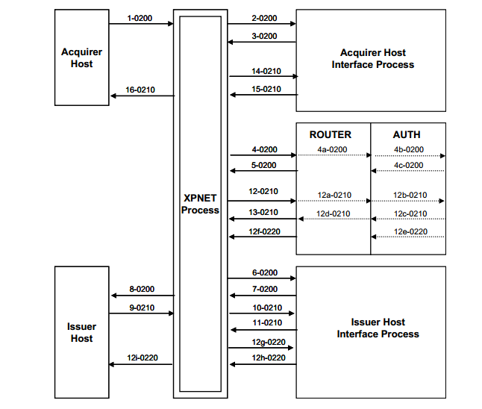
POS Incoming Message Flow

Slide 9
POS Detailed Processing
Steps Processing
1-2 A host/interchange acquires the transaction request. This acquirer host sends the transaction request to the BASE24-pos system in external message format, where it is received by the acquirer Interface process.
3–4 The Interchange Interface process reformats the request message into the POS Standard Internal Message (PSTM) format, sets a response timer, and sends the 0200 request message to the Router/
Authorization(RTAU) process. (When transactions are received from a host/interchange the Device Handler module is not required.)
4a-4c The Router module finds the retailer’s record in the POS Retailer Definition File (PRDF), locates a Card Prefix File (CPF) record for the card involved in the transaction. The Router module then passes the message to the Authorization module. From the CPF, the Authorization module locates an Institution
Definition File (IDF) record for the institution that issued the card. The IDF record identifies how the transaction request is to be processed. The request passes all prescreening checks.
ICFE
CPF
IDF
PRDF

Slide 10
POS Detailed Processing
Steps Processing
5-6 The Router/Authorization process sends the 0200 message to the issuer ISO Host Interface process.
7-8 The ISO Host Interface process reformats the request into an external message format, sets an outbound request timer, and sends the request as a 0200 message to the host.
9-10 The issuer host approves the transaction request and returns a 0210 response message to the issuer ISO Host Interface process.
11-12 The issuer ISO Host Interface process deletes its outbound request timer, reformats the external message into a PSTM, and sends the response as a 0210 message to the Router/Authorization Process.
12a–12d The Authorization module updates its authorization files if they are being maintained by the BASE24-pos system and logs the response to the POS Transaction Log File (PTLF).
12e–12g The Router/Authorization process formats and sends a 0220 completion message to the issuer ISO Host Interface process.
PTLF

Slide 11
POS Detailed Processing
Steps Processing
12h–12i The issuer ISO Host Interface process reformats the 0220 completion message into an external message format and sends the completion message to the host. The completion message notifies the host that
the transaction completed as authorized.
13-14 The Router/Authorization process formats a 0210 response message and sends it to the acquirer ISO Host Interface process.
15-16 The acquirer ISO Host Interface process reformats the 0210 response into external message format, deletes the response timer, and sends the response to the acquirer host.

Slide 12
Hypercom DH
Translates Message Formats
Performs Consistency Checks on Messages
Maintains Transaction Timer
Performs PIN Decryption
Assign transaction sequence numbers to transactions if the originating POS terminals are not capable of assigning them
Router & Authorization modules bound with HPDH process, perform the routing & authorization part
The Hypercom External Message is a variable-content, variable-length message, based on the ISO 8583 message format developed by the International Organization for Standardization (ISO).
In addition, two major components that allow the HPDH module to perform its functions are the network access controller (NAC) and the network management system (NMS). The NAC provides end-to-end network optimization and concentration to free the host of processing that is better handled elsewhere. The NMS provides a method to control NACs and terminals throughout the network.
The NAC is required in order to use the HPDH module with BASE24-pos, whereas the NMS is optional.

Slide 13
Router Module Processing
The Router module receives messages and routes them to hosts, interchanges, a Transaction Context Manager process, Router modules in other logical networks, or its bound Authorization module. The Router module can receive messages from its bound Device Handler module, an ISO Host Interface process, an Interchange Interface process a Transaction Context Manager process, or another logical network.
Tasks of the Router Module
When the Router module receives a transaction message, it performs the following
tasks:
Determines whether the message can be routed to an authorizing entity. The Router module determines how to route the transaction according to information from files and the POS Standard Internal Message (PSTM). If the Router module cannot obtain the information it needs to route a transaction, it denies the transaction request.
Determines the routing parameters to use for the transaction and sets fields in the PSTM based on those parameters. Routing parameters include the primary authorizer, alternate authorizers, override destination, and offline limits. At this point, the Router module can determine an authorizer.

Slide 14
Router Module Processing
Sends the message to the appropriate authorizer. If the authorizer is the Authorization module, the Router module passes the message to that module. If the authorizer is an interchange, host, or Router/Authorization process in another logical network, the Router module sends the message to the XPNET process to be routed to the appropriate Interchange Interface, ISO Host Interface, or Router/Authorization process.

Slide 15
Authorization Module Processing
The Authorization module receives transactions from the Router module and authorizes them according to an institution’s authorization parameters and controls. The Authorization module is responsible for selecting appropriate routing and authorization parameters from the Institution Definition File (IDF) Routing Table, The Authorization module also logs transactions to a POS Transaction Log File (PTLF),

Slide 16
Interchange Interface
Serves as a link between two networks.
Adheres to Certified standards (e.g. Visa/MDS)
These standards include sending and accepting the appropriate form of the external message
Facilitating settlement between BASE24 and Interchanges.
Providing store and forward (SAF) capabilities.
Managing communications between BASE24 and Interchanges

Slide 17
Host Interface
Formats messages
Performs host availability
Handles timing check on requests to host
Supports flexible ISO message contents
Controls store and forward (SAF) processing

Slide 18
Questions …!

